Slide 1
MA3077 (DLI) Operational Research Lecture 8 – Integer modelling
Dr Marco Fasondini

Slide 2
Recap and plan of the day
Summary: we have learnt:
how to model some mixed-integer linear programming problems,
how to solve them in Matlab using intlinprog,
what the branch and bound technique is,
and that some mixed-integer problems have a so-called integer solution property.
Today: More modelling using integer variables, following closely chapter 9.1 of the Mosek Cookbook.

Slide 3
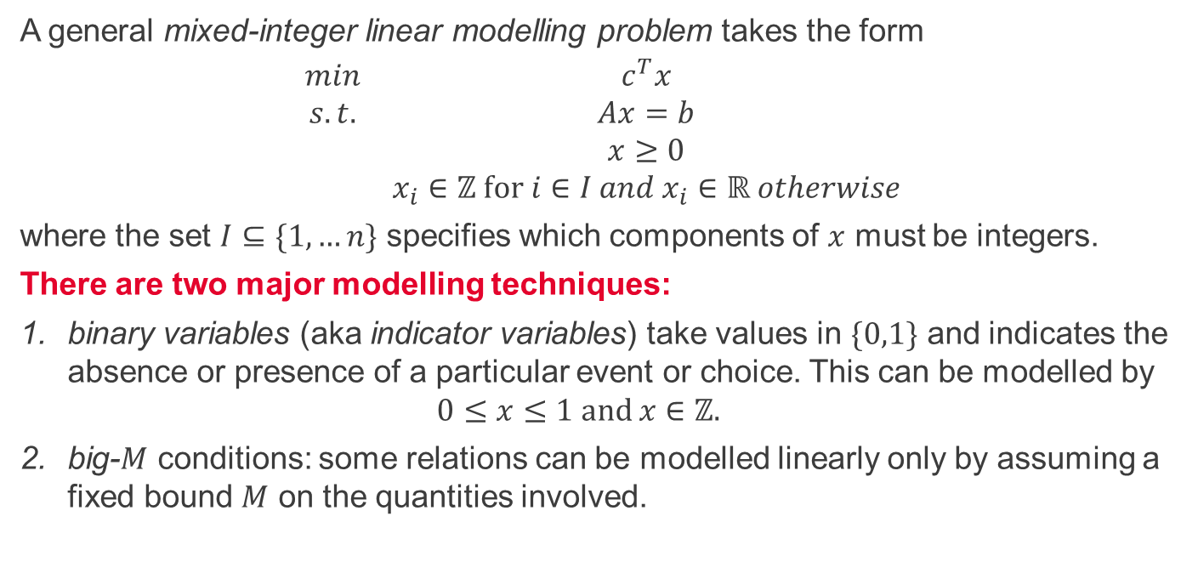
Mixed-integer linear modelling
A general mixed-integer linear modelling problem takes the form
$$\begin{matrix}min & c^{T}x \\ s.t. & Ax=b \\ & x≥0 \\ & x_{i}∈ℤ for i∈I and x_{i}∈ℝ otherwise\end{matrix}$$
where the set $I⊆\{1,…n\}$ specifies which components of $x$ must be integers.
There are two major modelling techniques:
binary variables (aka indicator variables) take values in $\{0,1\}$ and indicates the absence or presence of a particular event or choice. This can be modelled by $0≤x≤1 and x∈ℤ.$
big-$M$ conditions: some relations can be modelled linearly only by assuming a fixed bound $M$ on the quantities involved.

Slide 4
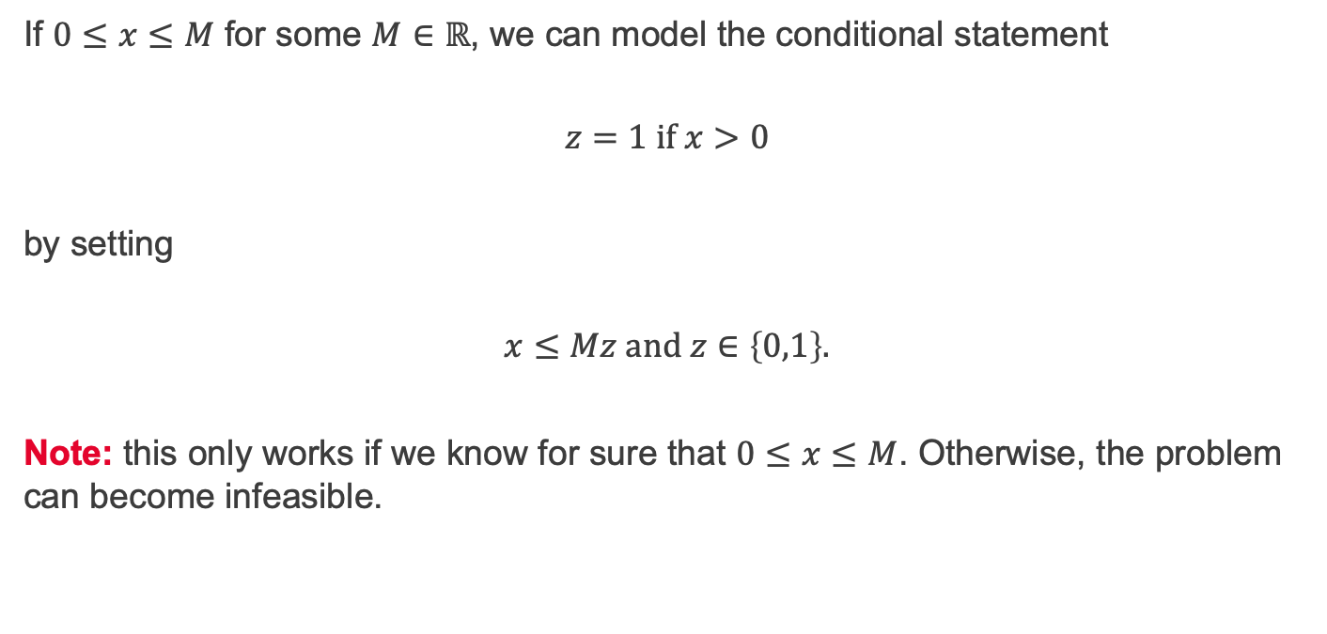
Implication of positivity
If $0≤x≤M$ for some $M∈ℝ$, we can model the conditional statement
$$z=1 if x>0$$
by setting
$$x≤Mz and z∈\left\{0,1\right\}.$$
Note: this only works if we know for sure that $0≤x≤M$. Otherwise, the problem can become infeasible.

Slide 5
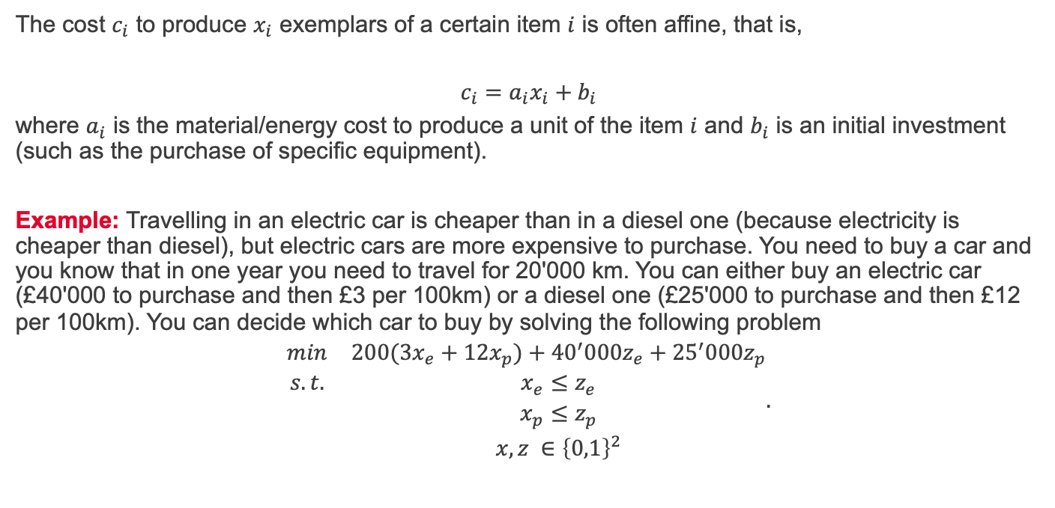
Implication of positivity - example
The cost $c_{i}$ to produce $x_{i}$ exemplars of a certain item $i$ is often affine, that is,
$$c_{i}=a_{i}x_{i}+b_{i}$$
where $a_{i}$ is the material/energy cost to produce a unit of the item $i$ and $b_{i}$ is an initial investment (such as the purchase of specific equipment).
Example: Travelling in an electric car is cheaper than in a diesel one (because electricity is cheaper than diesel), but electric cars are more expensive to purchase. You need to buy a car and you know that in one year you need to travel for 20'000 km. You can either buy an electric car (£40'000 to purchase and then £3 per 100km) or a diesel one (£25'000 to purchase and then £12 per 100km). You can decide which car to buy by solving the following problem
$$\begin{matrix}min & 200(3x_{e}+12x_{p})+{40}^{′}000z_{e}+{25}^{′}000z_{p} \\ s.t. & x_{e}≤z_{e} \\ & x_{p}≤z_{p} \\ & x, z ∈{\left\{0,1\right\}}^{2}\end{matrix}.$$

Slide 6
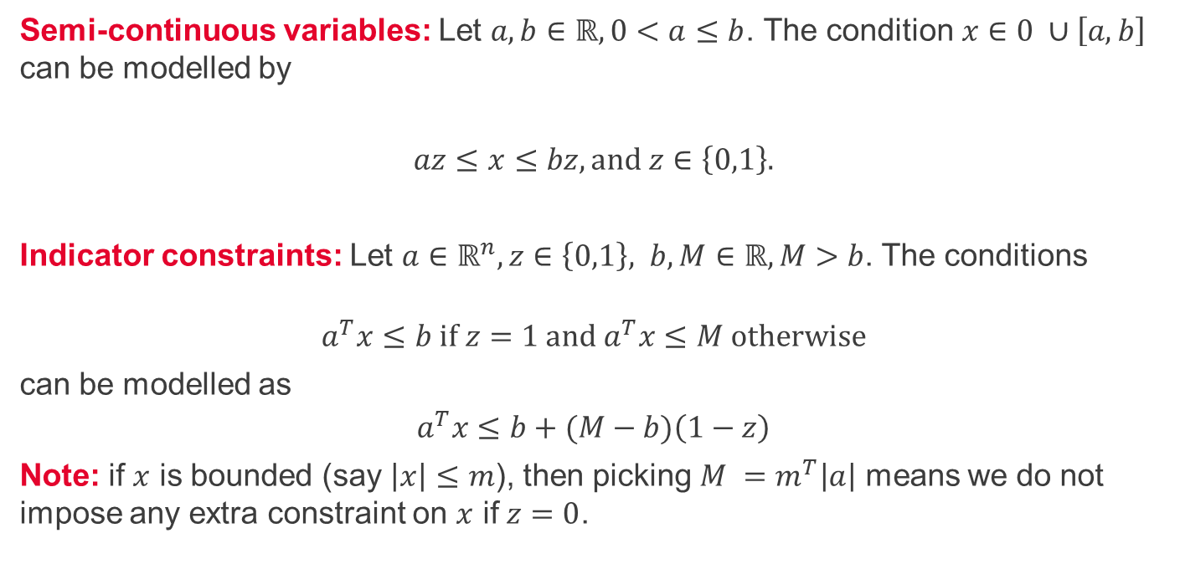
Semi-continuous variable, indicator constraints
Semi-continuous variables: Let $a,b∈ℝ, 0<a≤b$. The condition$x∈0 ∪\left[a,b\right]$ can be modelled by
$$az≤x≤bz, and z∈\left\{0,1\right\}.$$
Indicator constraints: Let $a∈ℝ^{n},z∈\left\{0,1\right\}, b,M∈ℝ, M>b$. The conditions
$$a^{T}x≤b if z=1 and a^{T}x≤M otherwise$$
can be modelled as
$$a^{T}x≤b+(M−b)\left(1−z\right)$$
Note: if $x$ is bounded (say $\left|x\right|≤m$), then picking $M =m^{T}\left|a\right|$ means we do not impose any extra constraint on $x$ if $z=0$.

Slide 7
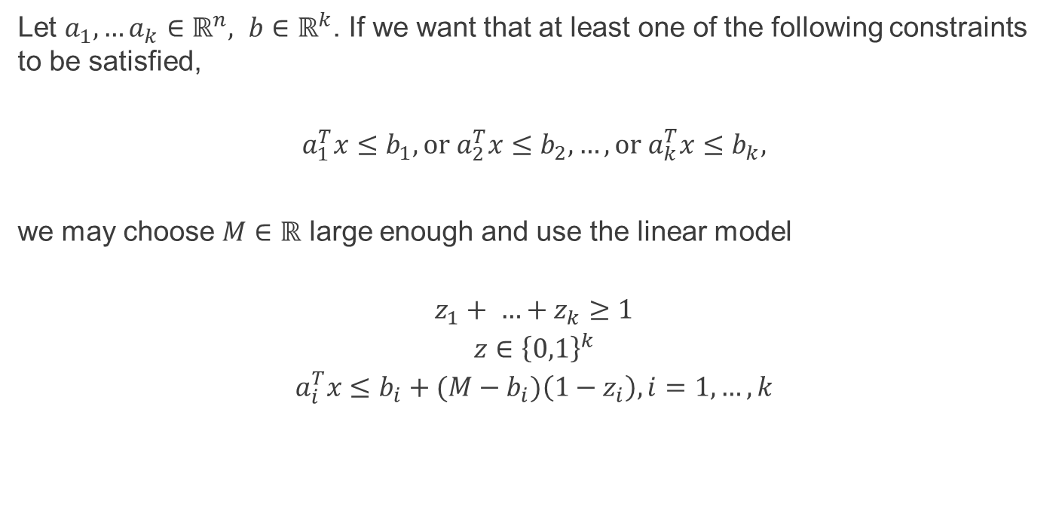
Disjunctive constraints
Let $a_{1},…a_{k}∈ℝ^{n}, b∈ℝ^{k}$. If we want that at least one of the following constraints to be satisfied,
$$a_{1}^{T}x≤b_{1},or a_{2}^{T}x≤b_{2}, …, or a_{k}^{T}x≤b_{k},$$
we may choose $M∈ℝ$ large enough and use the linear model
$$\begin{matrix}z_{1}+ …+z_{k}≥1 \\ z∈{\left\{0,1\right\}}^{k} \\ a_{i}^{T}x≤b_{i}+(M−b_{i})\left(1−z_{i}\right), i=1,…,k\end{matrix}$$

Slide 8

Constraint satisfaction
If $m<b<M$ we can distinguish between the two options
$$either m≤a^{T}x≤b or b≤a^{T}x≤M$$
with the linear model
$$b+\left(m−b\right)z≤a^{T}x≤b+\left(M−b\right)\left(1−z\right), z∈\{0,1\}$$

Slide 9

Exact absolute value
Let $x∈ℝ.$ In a previous lecture, we saw how to model $\left|x\right|≤t.$
If $\left|x\right|≤M$, we can model the exact equality $t=\left|x\right|$ $∈ℝ$ as follows
$$\begin{matrix}x=a −b \\ \begin{aligned}t=a+b \\ a,b≥0∈ℝ \\ a≤Mz \\ b≤M(1−z)\end{aligned} \\ z∈\{0,1\}\end{matrix}$$

Slide 10

Exact $ℓ_{1}$-norm
Let $x∈ℝ^{n}.$ In a previous lecture, we saw how to model $${\left\|x\right\|}_{{ ℓ}_{1}}= \sum_{i=1}^{n}{\left|x\right|}≤t.$$
We can model the exact equality $t={\left\|x\right\|}_{{ ℓ}_{1}}∈ℝ$ as follows
$$\begin{matrix}x=a −b \\ \begin{aligned}\sum_{i=1}^{n}{a_{i}+b_{i}=t} \\ a,b≥0∈ℝ^{n} \\ a≤Mz \\ b≤M\left(1−z\right)\end{aligned} \\ z∈{\left\{0,1\right\}}^{n}\end{matrix}$$

Slide 11
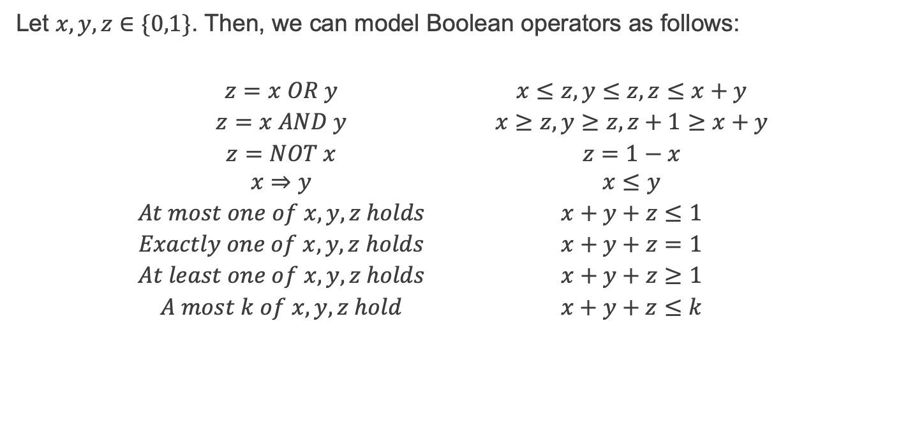
Boolean operators
Let $x,y,z∈\{0,1\}$. Then, we can model Boolean operators as follows:
$$\begin{matrix}z=x OR y & & x≤z, y≤z, z≤x+y \\ z=x AND y & & x≥z, y≥z, z+1≥x+y \\ z=NOT x & & z=1−x \\ x⇒y & & x≤y \\ At most one of x,y,z holds & & x+y+z≤1 \\ Exactly one of x,y,z holds & & x+y+z=1 \\ At least one of x,y,z holds & & x+y+z≥1 \\ A most k of x,y,z hold & & x+y+z≤k\end{matrix}$$

Slide 12
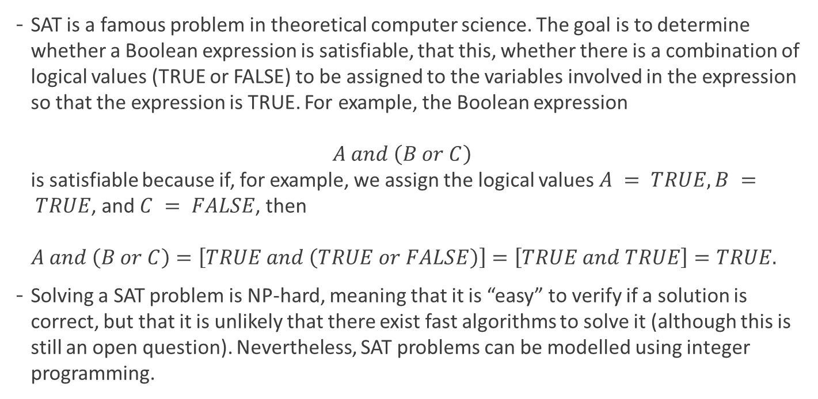
Boolean operators - example
SAT is a famous problem in theoretical computer science. The goal is to determine whether a Boolean expression is satisfiable, that this, whether there is a combination of logical values (TRUE or FALSE) to be assigned to the variables involved in the expression so that the expression is TRUE. For example, the Boolean expression $A and \left(B or C\right)$ is satisfiable because if, for example, we assign the logical values $A = TRUE, B = TRUE$, and $C = FALSE$, then $A and \left(B or C\right)=\left[TRUE and \left(TRUE or FALSE\right)\right]=\left[TRUE and TRUE\right]=TRUE.$
Solving a SAT problem is NP-hard, meaning that it is “easy” to verify if a solution is correct, but that it is unlikely that there exist fast algorithms to solve it (although this is still an open question). Nevertheless, SAT problems can be modelled using integer programming.

Slide 13

Boolean operators - example
Question: create a linear integer programming problem to determine a solution $(A,B,C,D)$ to the SAT problem $\left(A and not B\right) and \left(C or D\right),$
with as few variables set to TRUE as possible.

Slide 14
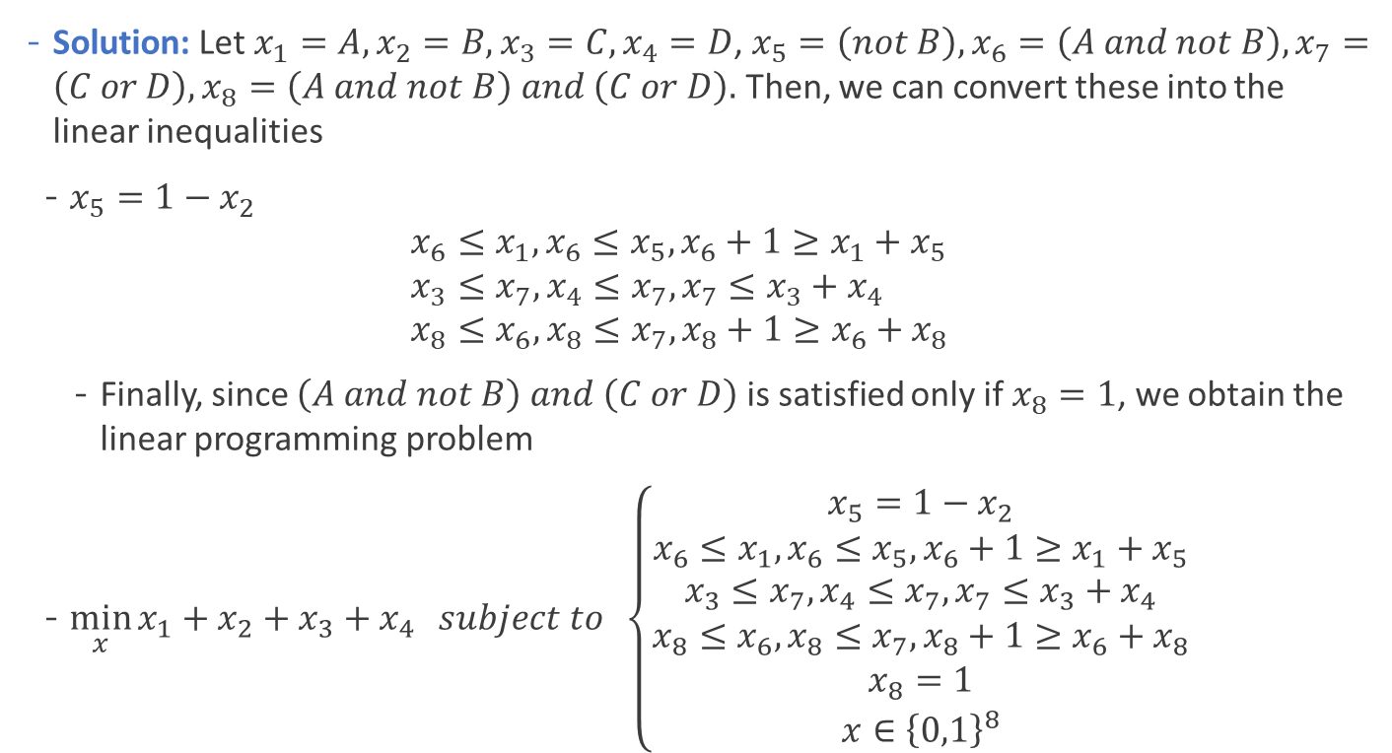
Boolean operators - example
Solution: Let $x_{1}=A,x_{2}=B,x_{3}=C, x_{4}=D$, $x_{5}=\left(not B\right), x_{6}=\left(A and not B\right), x_{7}=\left(C or D\right), x_{8}=\left(A and not B\right) and \left(C or D\right).$ Then, we can convert these into the linear inequalities
$x_{5}=1−x_{2}$ $x_{6}≤x_{1}, x_{6}≤x_{5},x_{6}+1≥x_{1}+x_{5}$ $x_{3}≤x_{7},x_{4}≤x_{7},x_{7}≤x_{3}+x_{4}$ $x_{8}≤x_{6},x_{8}≤x_{7},x_{8}+1≥x_{6}+x_{8}$
Finally, since $\left(A and not B\right) and \left(C or D\right)$ is satisfied only if $x_{8}=1$, we obtain the linear programming problem
$\min_{x}{x_{1}+x_{2}+x_{3}+x_{4}} subject to \left\{\begin{aligned}x_{5}=1−x_{2} \\ x_{6}≤x_{1}, x_{6}≤x_{5},x_{6}+1≥x_{1}+x_{5} \\ x_{3}≤x_{7},x_{4}≤x_{7},x_{7}≤x_{3}+x_{4} \\ x_{8}≤x_{6},x_{8}≤x_{7},x_{8}+1≥x_{6}+x_{8} \\ x_{8}=1 \\ x∈{\left\{0,1\right\}}^{8}\end{aligned}\right.$

Slide 15

Bilinear equality
Let $x,y∈ℝ$. The bilinear constraint $xy=0$, which models the alternative
$$x=0 or y=0,$$
can be modelled as
$$\begin{matrix}\left|x\right|≤Mz \\ \left|y\right|≤M(1−z) \\ z∈\{0,1\}\end{matrix}$$
for a suitable constant $M$.

Slide 16
Summary and self-study
Summary: today we have learnt
how to model some nonlinear functions using mixed-integer linear programming.
Self-study: Consider the self-study exercise from OR Lecture 7.pptx, but now assume my colleague collected 10 projects instead of 7. How should he modify the corresponding mixed-integer linear programming problem? Note that he cannot run all 10 projects because there are only 32 students and each project should have at least 4 students.

